Slide 1
TIMER in atmega32
Md. Tareq Mahmood

Slide 2
One more Slide???

Slide 3
Learning Objective
What is timer?
When, how to use timer?

Slide 4
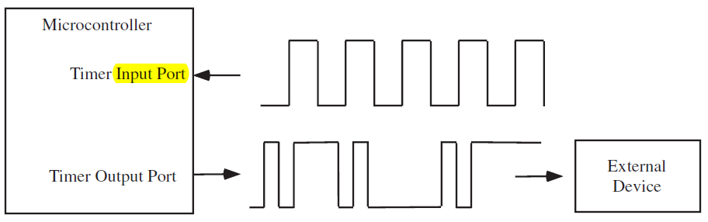
Time is “money”
An embedded system has to preform various time-related tasks
Recording the time when an event occurs
Calculating the time difference between two events
Performing tasks at specific or periodic time instants
Creating accurate time delays
Generating waveforms of certain shape, period or duty cycle

Slide 5
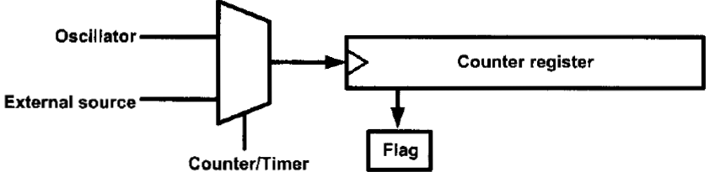
Software technique?
Can we use CPU to do these tasks?
Yes!
But…
CPU will be busy
Timing will not be accurate
Need something special?
Hardware technique

Slide 6
PROBLEM DELAY_MS
If an ISR is fired during the execution of a delay_ms(),
ISR will be serviced first, then delay will continue
Resulting in more delay than specified
For example,
If you call _delay_ms(1) and some ISR occurs that take 200us to be serviced, _delay_ms(1) takes 1.2ms

Slide 7
Overview
ATmega32 has 3 timers
Timer 0, 1, 2
Timer 1 has the most functionalities
Each timer is associated with
A counter
A clock signal
Internal
External

Slide 8
Overview
When the internal system clock is used, a prescaler can be used to make the timer count at a slower rate
Example:
Suppose the system clock rate = 1Mhz (1μs per cycle).
Suppose a timer prescaler of 64 is used.
Then, timer will increment every 64μs.

Slide 9
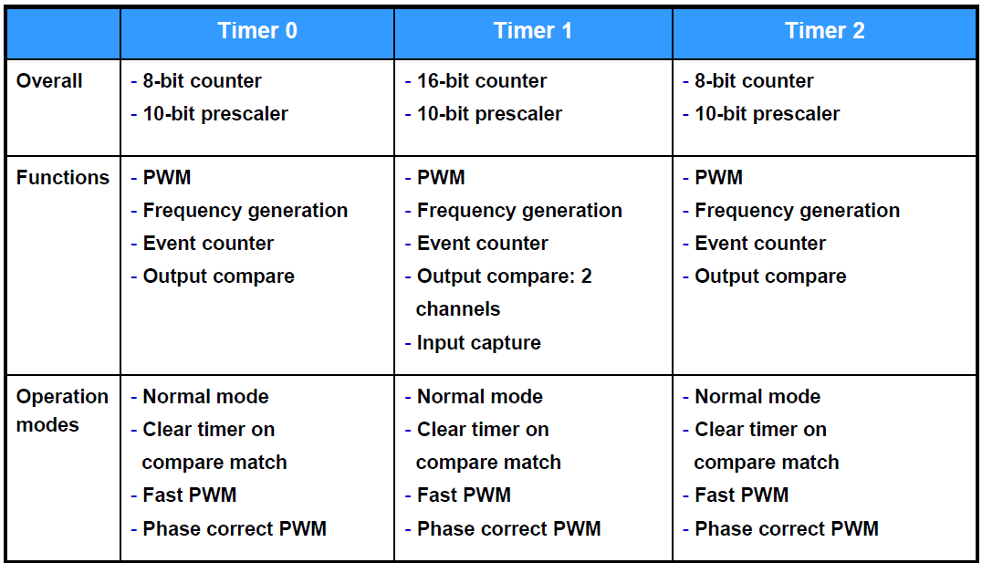

Slide 10
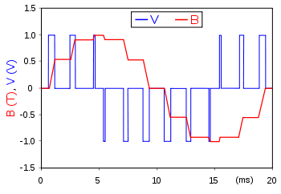
PWM
Pulse Width Modulation
A technique for getting analog results with digital means.
An example of PWM in an idealized inductor driven by a ■ voltage source modulated as a series of pulses, resulting in a ■ sine-like current in the inductor.

Slide 11
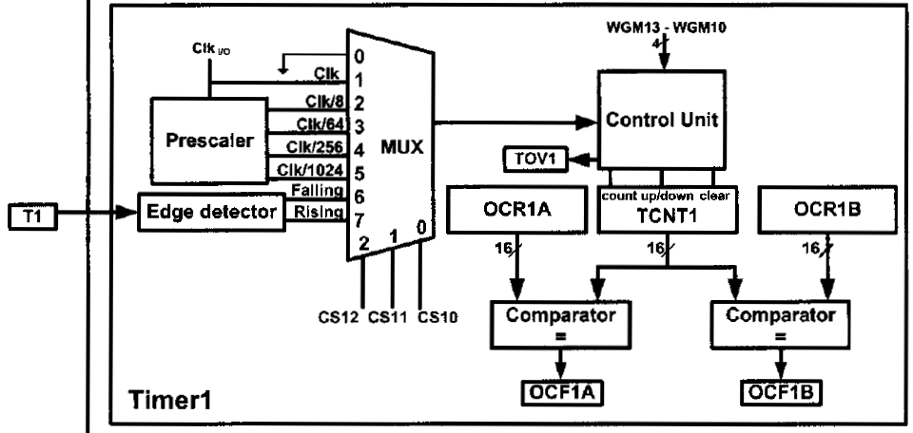
Timer 1

Slide 12
Timer 1
16 bit counter
prescaler: 8, 64, 256, 1024
Can trigger a timer overflow interrupt
and other things.. We will learn those in the subsequent lectures
Can trigger an input capture interrupt when an event occurs on the input capture pin
timer value is stored automatically in a register.
input capture pin for Timer 1 is ICP1 (D.6)

Slide 13
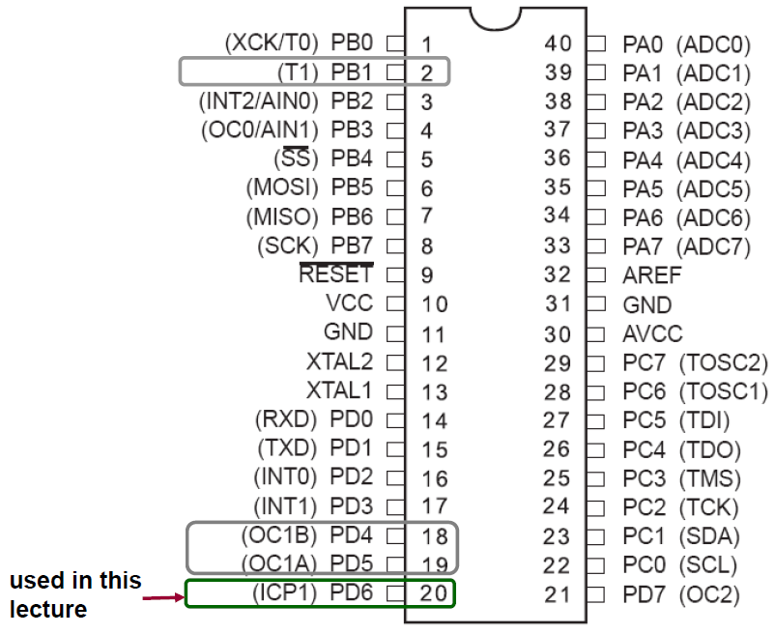
Timer 1 – Relevant pins

Slide 14
Related Registers – Timer1
TIMER/COUNTER1
TCNT1
16 bit register that stores the current value of the counter
Timer/Counter 1 Control Registers
TCCR1A and TCCR1B
To configure the operations of Timer 1.
Interrupt registers
TIMSK to enable timer interrupts
TIFR to monitor status of timer interrupts

Slide 15
Related Registers – Timer1
4. Input Capture Register
- ICR1
- to store timer value when an event occurs on input capture pin
5. Output Compare Registers

Slide 16
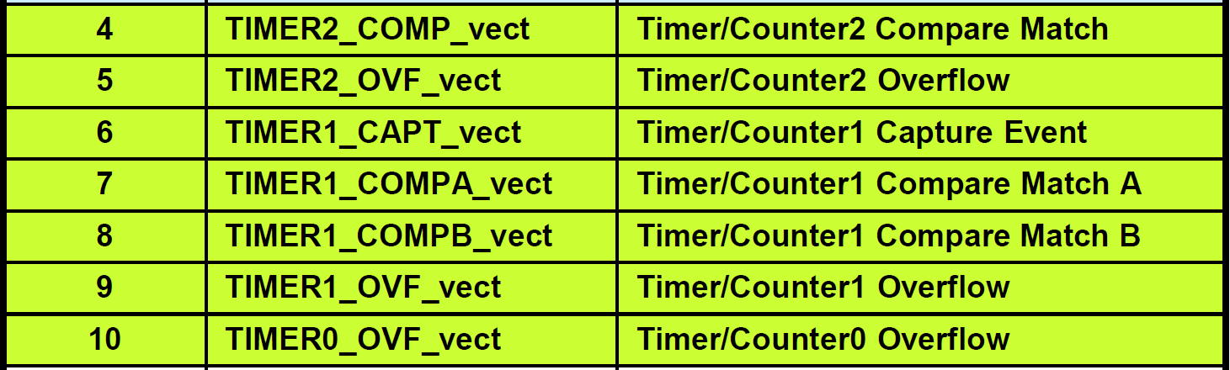
Timer related interrupts

Slide 17
Today’s mission
Creating an accurate delay using timer overflow interrupt
Measuring elapsed time between two events

Slide 18
Let’s start!!!

Slide 19
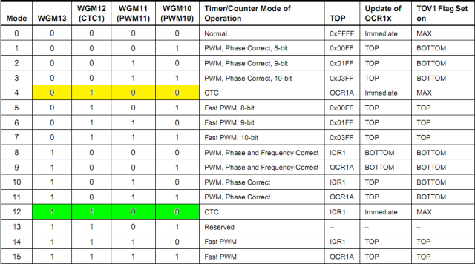
MODES

Slide 20
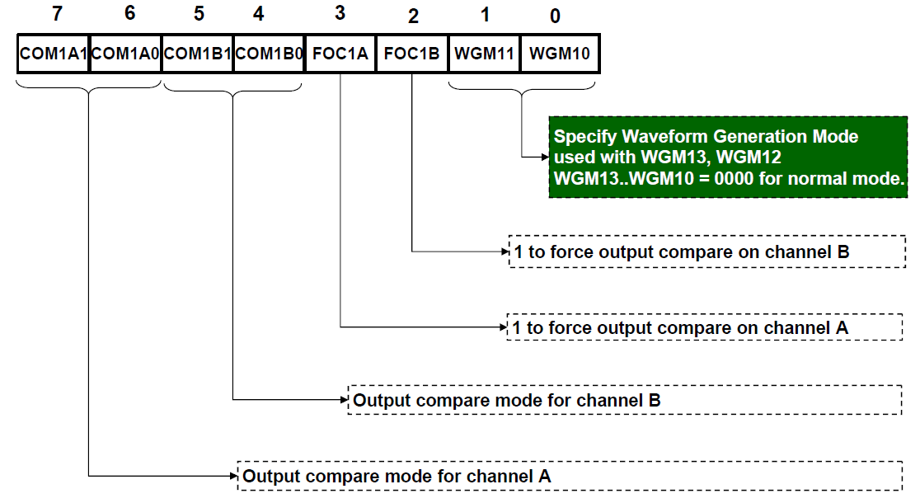
Timer/Counter 1 Control Register A (TCCR1A)

Slide 21
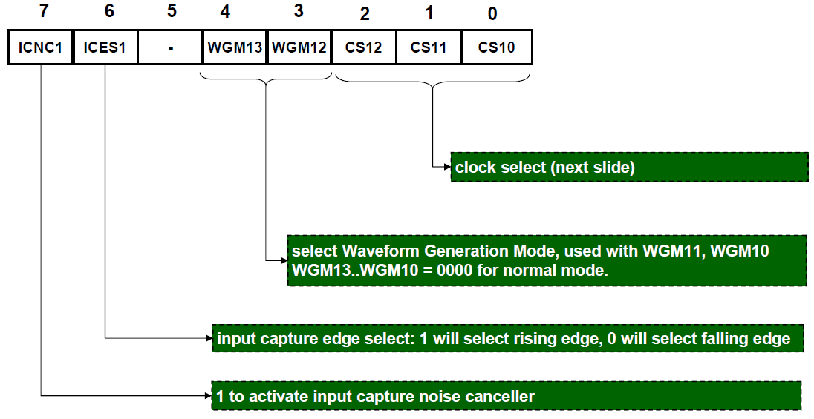
Timer/Counter 1 Control Register B (TCCR1B)

Slide 22
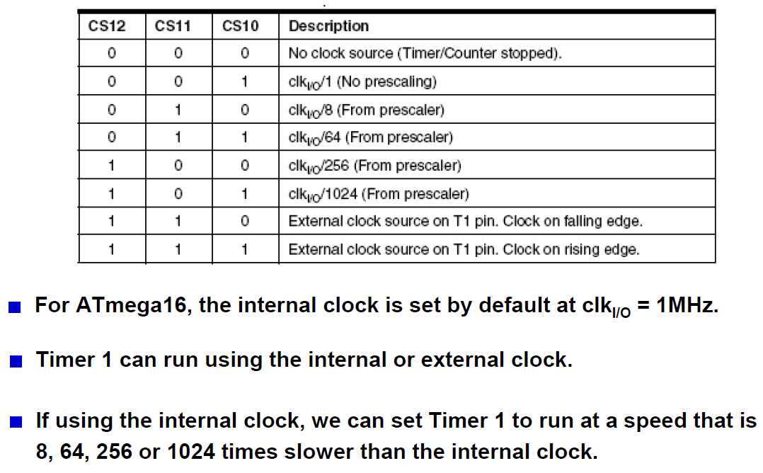
Clock select

Slide 23
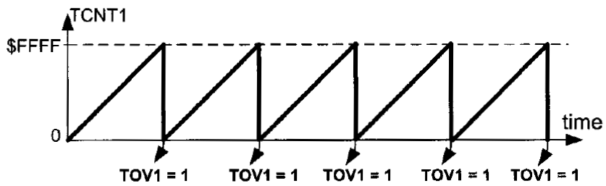
Normal mode

Slide 24
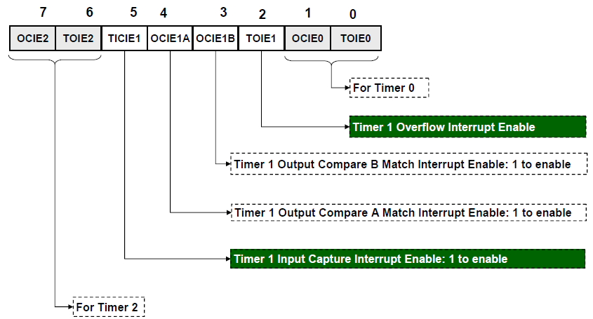
Timer/Counter Interrupt Mask Register (TIMSK)

Slide 25
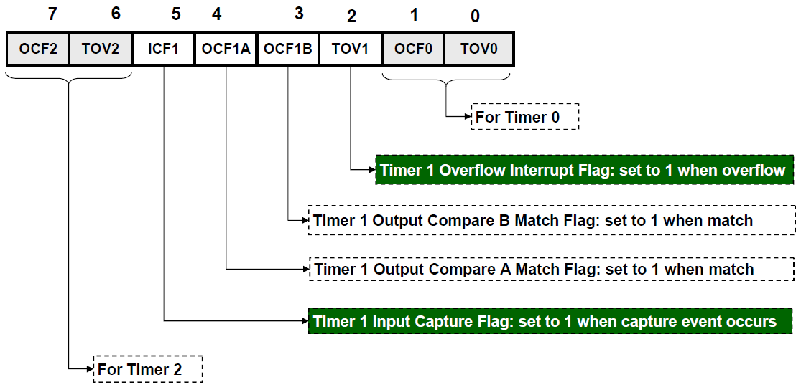
Timer/Counter Interrupt Flag Register (TIFR)

Slide 26
Write a C code to toggle PORTB every 2 seconds using TIMER 1 Overflow Interrupt

Slide 27
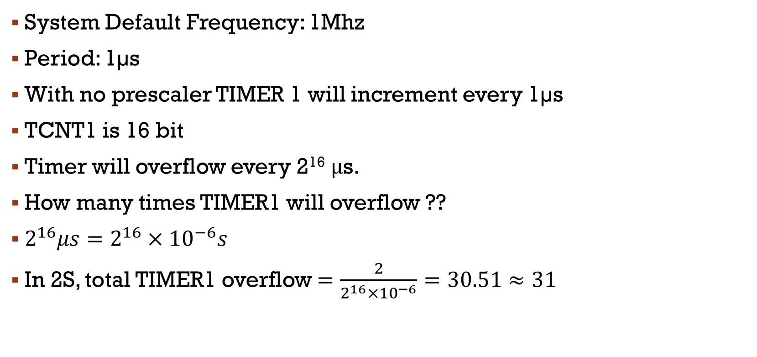
Creating an accurate delay of 2s
System Default Frequency: 1Mhz
Period: 1µs
With no prescaler TIMER 1 will increment every 1µs
TCNT1 is 16 bit
Timer will overflow every 2¹⁶ μs.
How many times TIMER1 will overflow ??
$2^{16}μs=2^{16}×{10}^{−6}s$
In 2S, total TIMER1 overflow $=\frac{2}{2^{16}×{10}^{−6}}=30.51≈31$

Slide 28
C Code
#include <avr/io.h>
#include <avr/interrupt.h>
volatile int overflowCount;
ISR(TIMER1_OVF_vect)
{
overflowCount++;
if(overflowCount==31)
{
PORTB = ~PORTB;
overflowCount = 0;
}
}
int main(void)
{
overflowCount = 0;
DDRB = 0xFF;
PORTB = 0xFF;
//configure timer
TCCR1A = 0b00000000; // normal mode
TCCR1B = 0b00000001; // no prescaler, internal clock
TIMSK = 0b00000100; //Enable Overflow Interrupt
sei(); //Global Interrupt Enable
while(1);
}

Slide 29
Appendix
Why volatile variable?
http://www.avrfreaks.net/forum/whats-volatile-variable

Slide 30
Measure the time for a demo C Code to execute

Slide 31
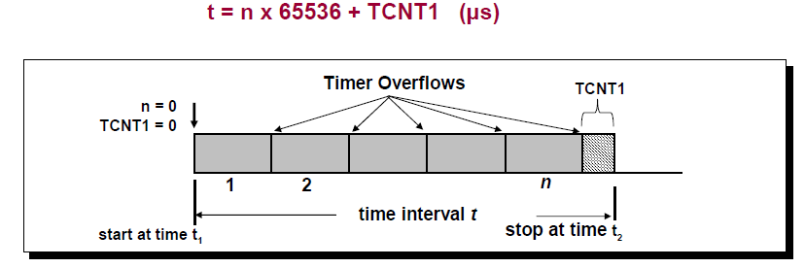
Measuring elapsed time

Slide 32
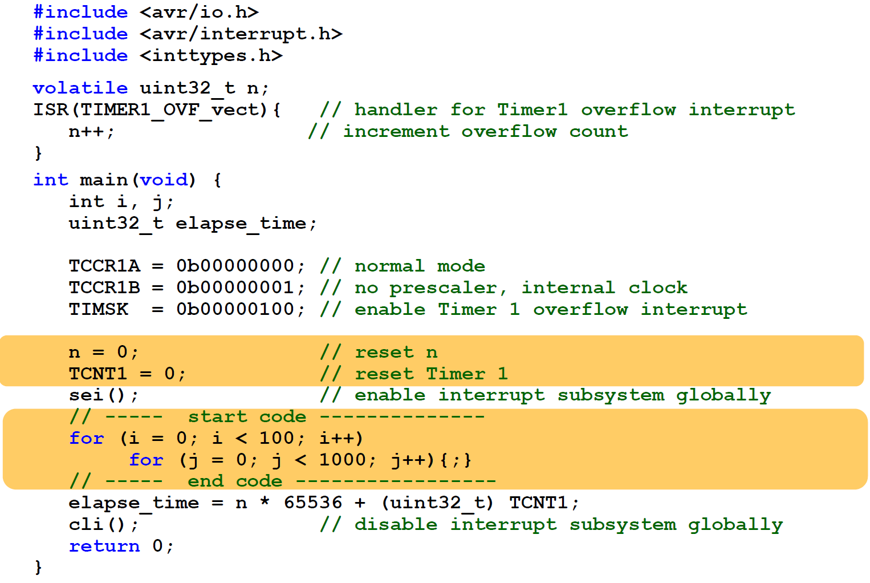

Slide 33


Slide 34
Thanks everyone!

